Slide 2
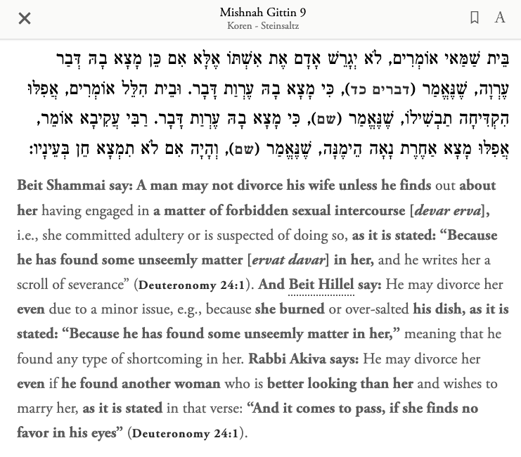


Slide 3
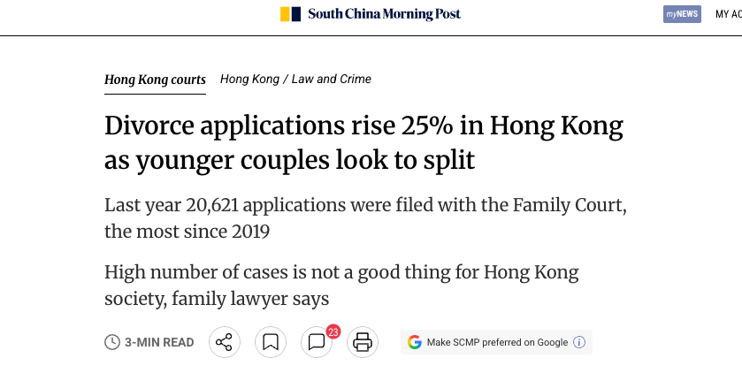

Slide 4
Marriage, Divorce and Singleness
Designed for Oneness
Divorce Is a Last Resort
Singleness Is a Calling

Slide 5
1. Designed for Oneness
Marriage was God’s idea (v.4-6, Gen 1:27)

Slide 6
1. Designed for Oneness
Marriage was God’s idea (v.4-6, Gen 1:27)
In marriage two become one (v.5, Gen 2:24), but in this fallen world, the unity is something that we must work at.
  Don’t stop dating your spouse
  Prioritize your marriage over other relationships (parents, children, work..etc.)
  Remember your marriage covenant

Slide 7

The Wedding Singer, 1995
“I wanna make you smile whenever you're sad / Carry you around when your arthritis is bad / All I wanna do is grow old with you.”

Slide 8

Anglican Marriage Vow
I take you… to have and to behold from this day forward, for better, for worse, for richer for poorer, in sickness and in health, to love and to cherish, until death do us part.”

Slide 9
1. Designed for Oneness
Marriage was God’s idea (v.4-6, Gen 1:27)
In marriage two become one (v.5, Gen 2:24), but in this fallen world, the unity is something that we must work at.
If you aren’t yet married – remember God’s design for marriage. Marrying a non-Christian shouldn’t be an option (1 Corinthians 7:39b).

Slide 10
2. Divorce Is a Last Resort
Adultery:
“Why then,” they asked, “did Moses command that a man give his wife a certificate of divorce and send her away?”
8 Jesus replied, “Moses permitted you to divorce your wives because your hearts were hard. But it was not this way from the beginning. 9 I tell you that anyone who divorces his wife, except for sexual immorality, and marries another woman commits adultery.”

Slide 11
2. Divorce Is a Last Resort
Desertion (1 Cor 7:15)
¹⁵ But if the unbeliever leaves, let it be so. The brother or the sister is not bound in such circumstances; God has called us to live in peace.

Slide 12
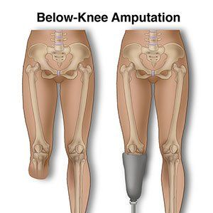
2. Divorce Is a Last Resort
Divorce is a concession that exists only in this fallen world; and it cuts like an amputation.

Slide 13
2. Divorce Is a Last Resort - Application
Keep going in your marriage.
  Join the Alpha Marriage Course in September.
  Talk to trusted members of the church.
For those who have gone through this…
  Jesus offers forgiveness, healing, and hope.
  God calls himself a divorcee (Jeremiah 3:8).
For the church
  Compassion, not judgment should be our response

Slide 14
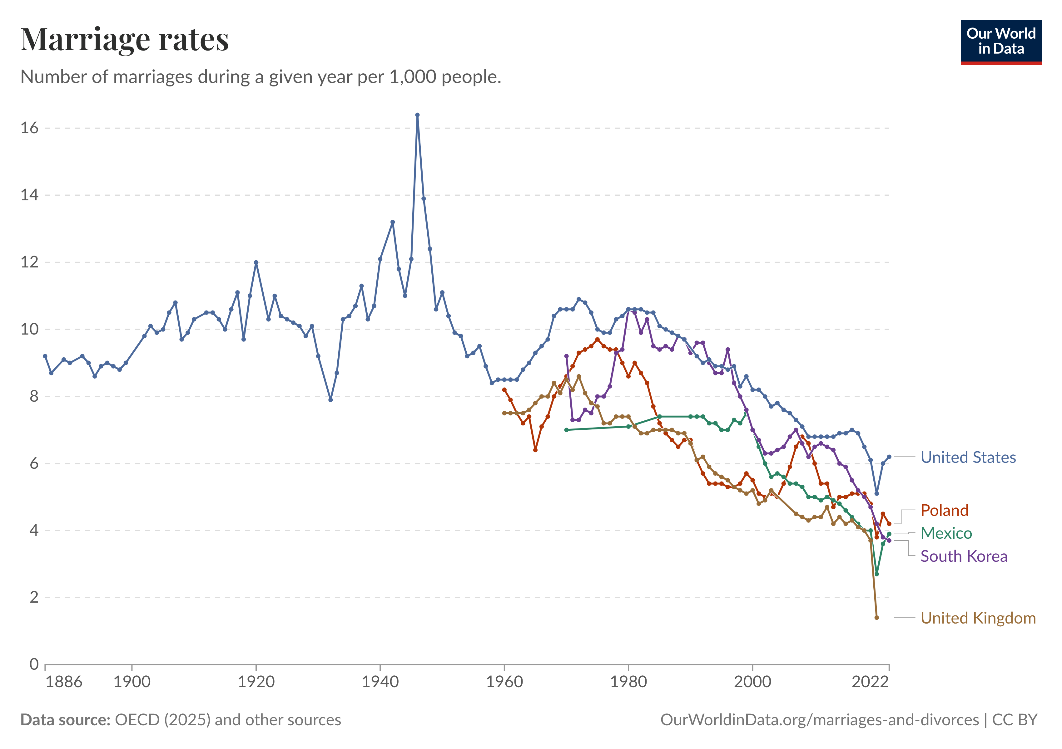
3. Singleness Is a Calling
If marriage is so difficult, why get married? (v.10)
  Millennials, Gen Z…etc.

Slide 15
3. Singleness Is a Calling
12 For there are eunuchs who were born that way, and there are eunuchs who have been made eunuchs by others—and there are those who choose to live like eunuchs for the sake of the kingdom of heaven. The one who can accept this should accept it.”
Prophet Jeremiah, John the Baptist, Apostle Paul, and Jesus. May Carmichael, John Stott, Dick Lucas, Vaughan Roberts…et. al.

Slide 16

3. Singleness Is a Calling
“Yet for those who are on the adventure called discipleship, singleness becomes a sign that the church lives by hope rather than biological heirs, that brothers and sisters come not through natural generation but through baptism, that the future of the world and the significance of our future is ultimately up to God rather than us.”

Slide 17
3. Singleness Is a Calling
But it’s a costly and difficult calling.
  We should honor those who serve God in this way - for life or for a time.
  We should support them as members of our family.

Slide 18
Marriage, Divorce and Singleness
Designed for Oneness
  Show the deep union of Christ and the Church
Divorce Is a Last Resort
  Show Christ’s sacrifice, even to death, to be united to us.
Singleness Is a Calling
  Shows Christ’s wholehearted devotion.

