Slide 2
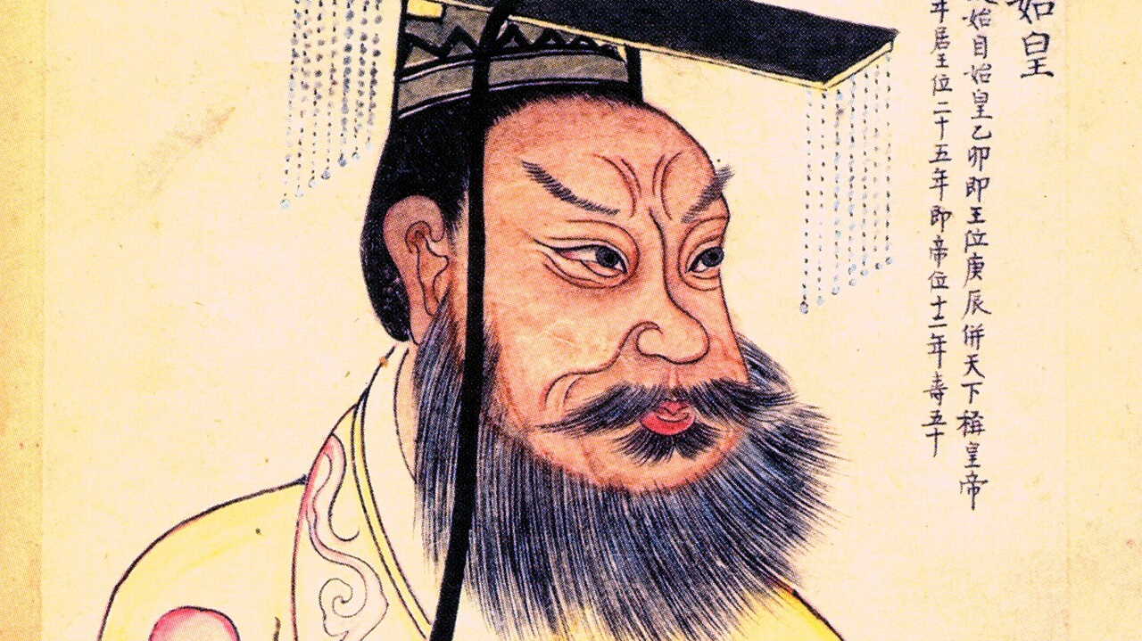

Slide 3
Matthew 19:13-30, Eternal Life
Jesus Makes a Way
Idols Keep Us Out
Our Great Reward

Slide 4
1. Jesus Makes a Way
¹⁶ Just then a man came up to Jesus and asked, “Teacher, what good thing must I do to get eternal life?”
²⁶ Jesus looked at them and said, “With man this is impossible, but with God all things are possible.”

Slide 5
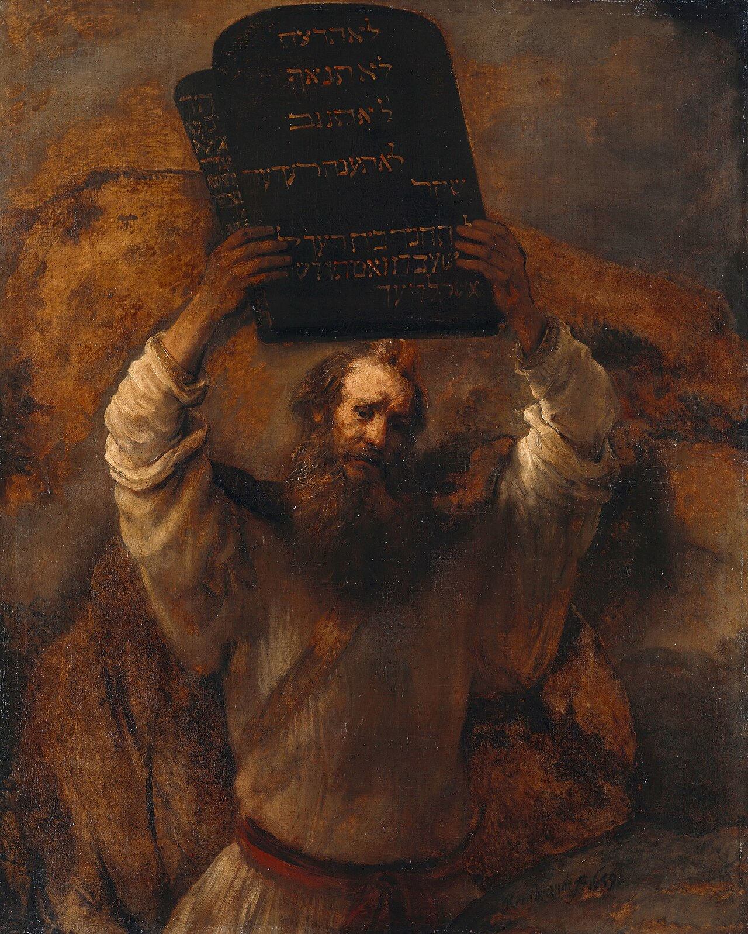
And God spoke all these words:
² “I am the Lord your God, who brought you out of Egypt, out of the land of slavery.
³ “You shall have no other gods before me.

Slide 6

1. Jesus Makes a Way
Our salvation is a gift!
  We see this in Jesus’ interaction with children
We respond with good works.

Slide 7
2. Idols Keep Us Out
²² When the young man heard this, he went away sad, because he had great wealth.

Slide 8


Slide 9
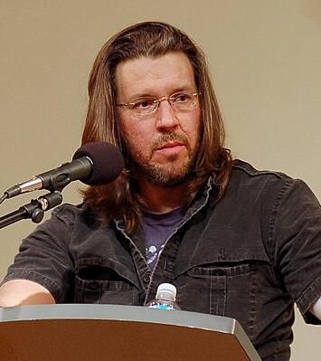
“If you worship money and things, if they are where you tap real meaning in life, then you will never have enough…. Worship your body and beauty and sexual allure and you will always feel ugly…. Worship power, you will end up feeling weak and afraid, and you will need ever more power over others to numb you to your own fear. Worship your intellect, being seen as smart, you will end up feeling stupid, a fraud, always on the verge of being found out.”
- David Foster Wallace

Slide 10
2. Idols Keep Us Out
What do I love, trust, or fear more than Jesus?
Take actions to leave your idols and turn to Christ!

Slide 11
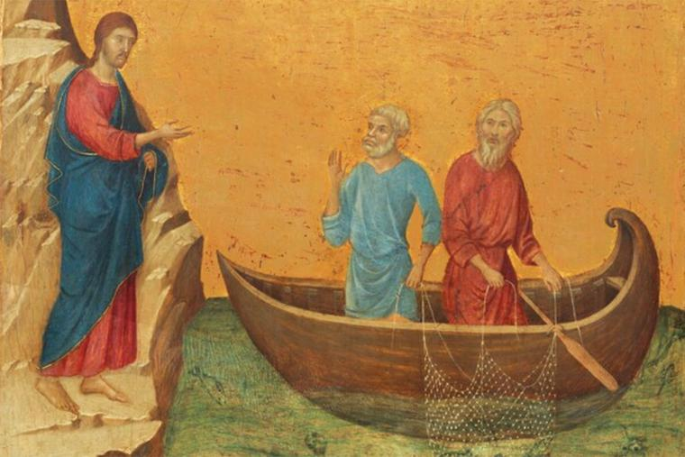
3. Our Great Reward

Slide 12
⁸ When Simon Peter saw this, he fell at Jesus’ knees and said, “Go away from me, Lord; I am a sinful man!”
- Luke 5:8

Slide 13
3. Our Great Reward
²⁹ And everyone who has left houses or brothers or sisters or father or mother or wife^{[e]} or children or fields for my sake will receive a hundred times as much and will inherit eternal life. ³⁰ But many who are first will be last, and many who are last will be first.

Slide 14
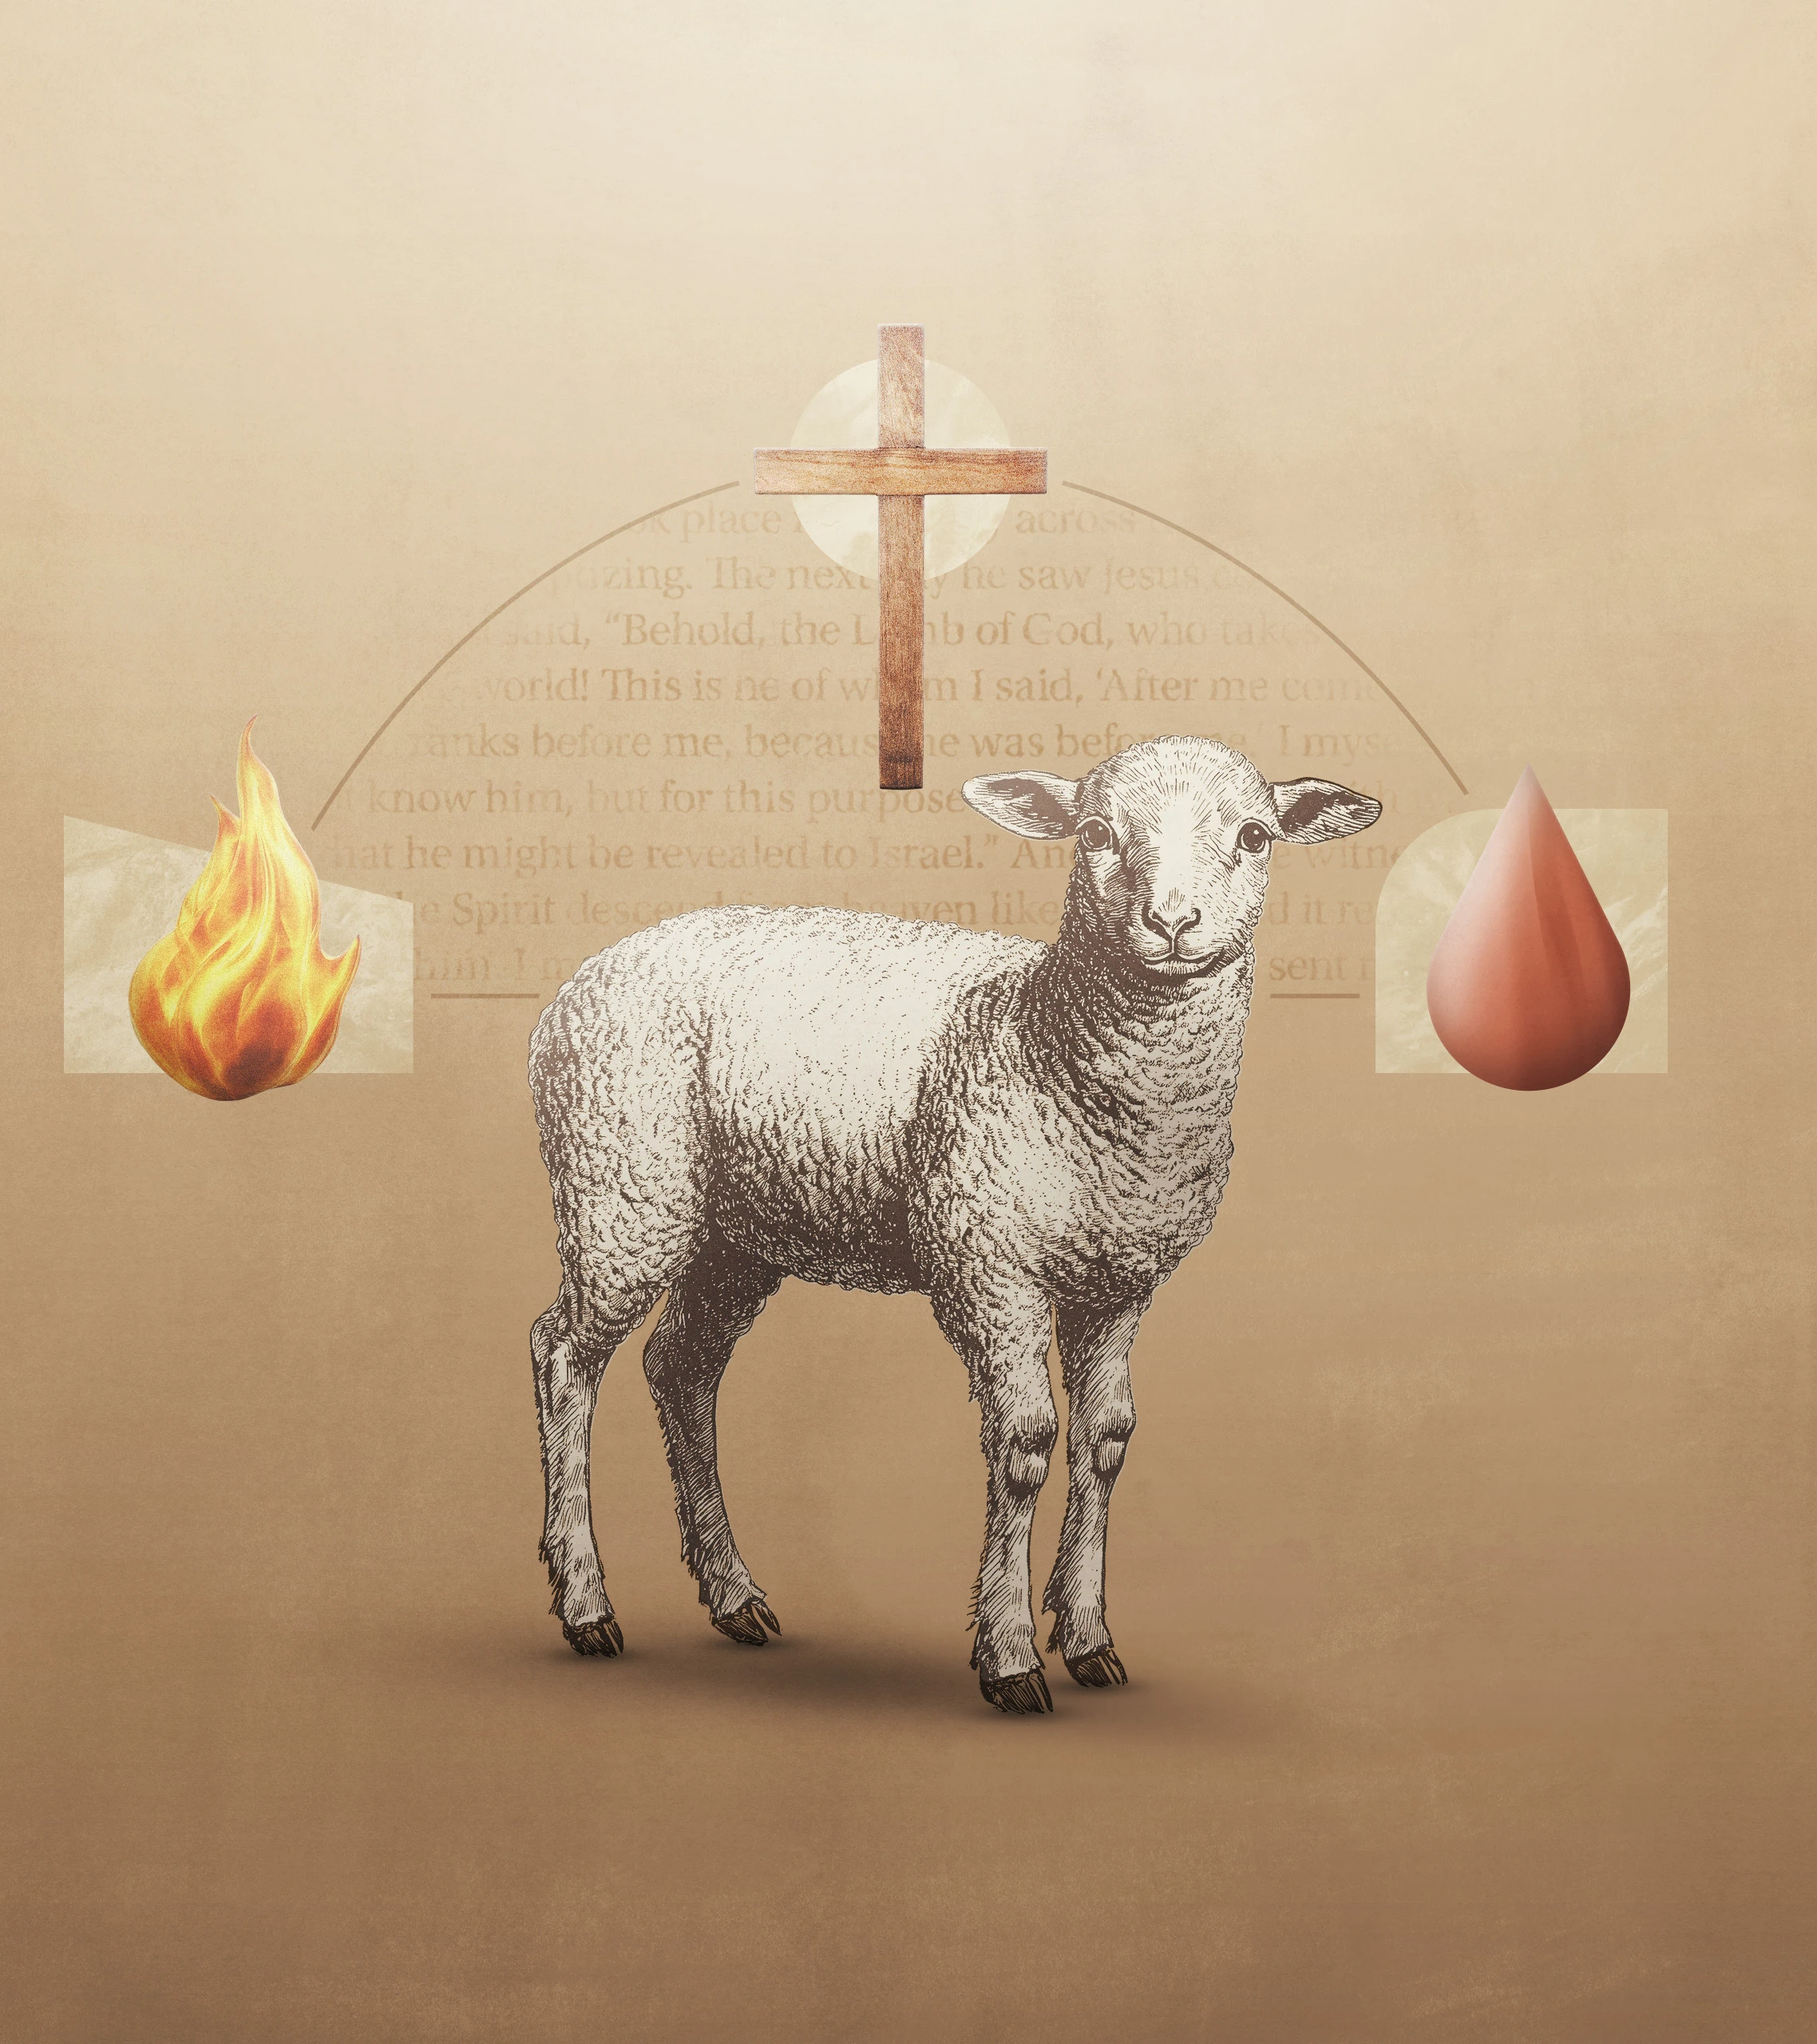
3. Our Great Reward
This is eternal life: that they may know you, the only God, and Jesus Christ whom you have sent (John 17:3).

