Slide 1


Slide 2
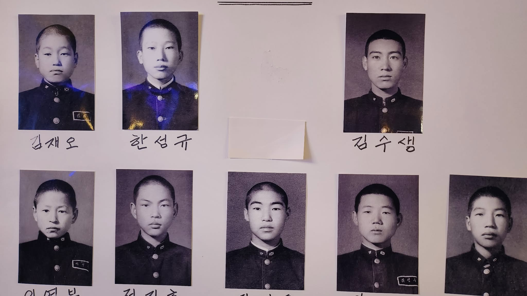

Slide 3
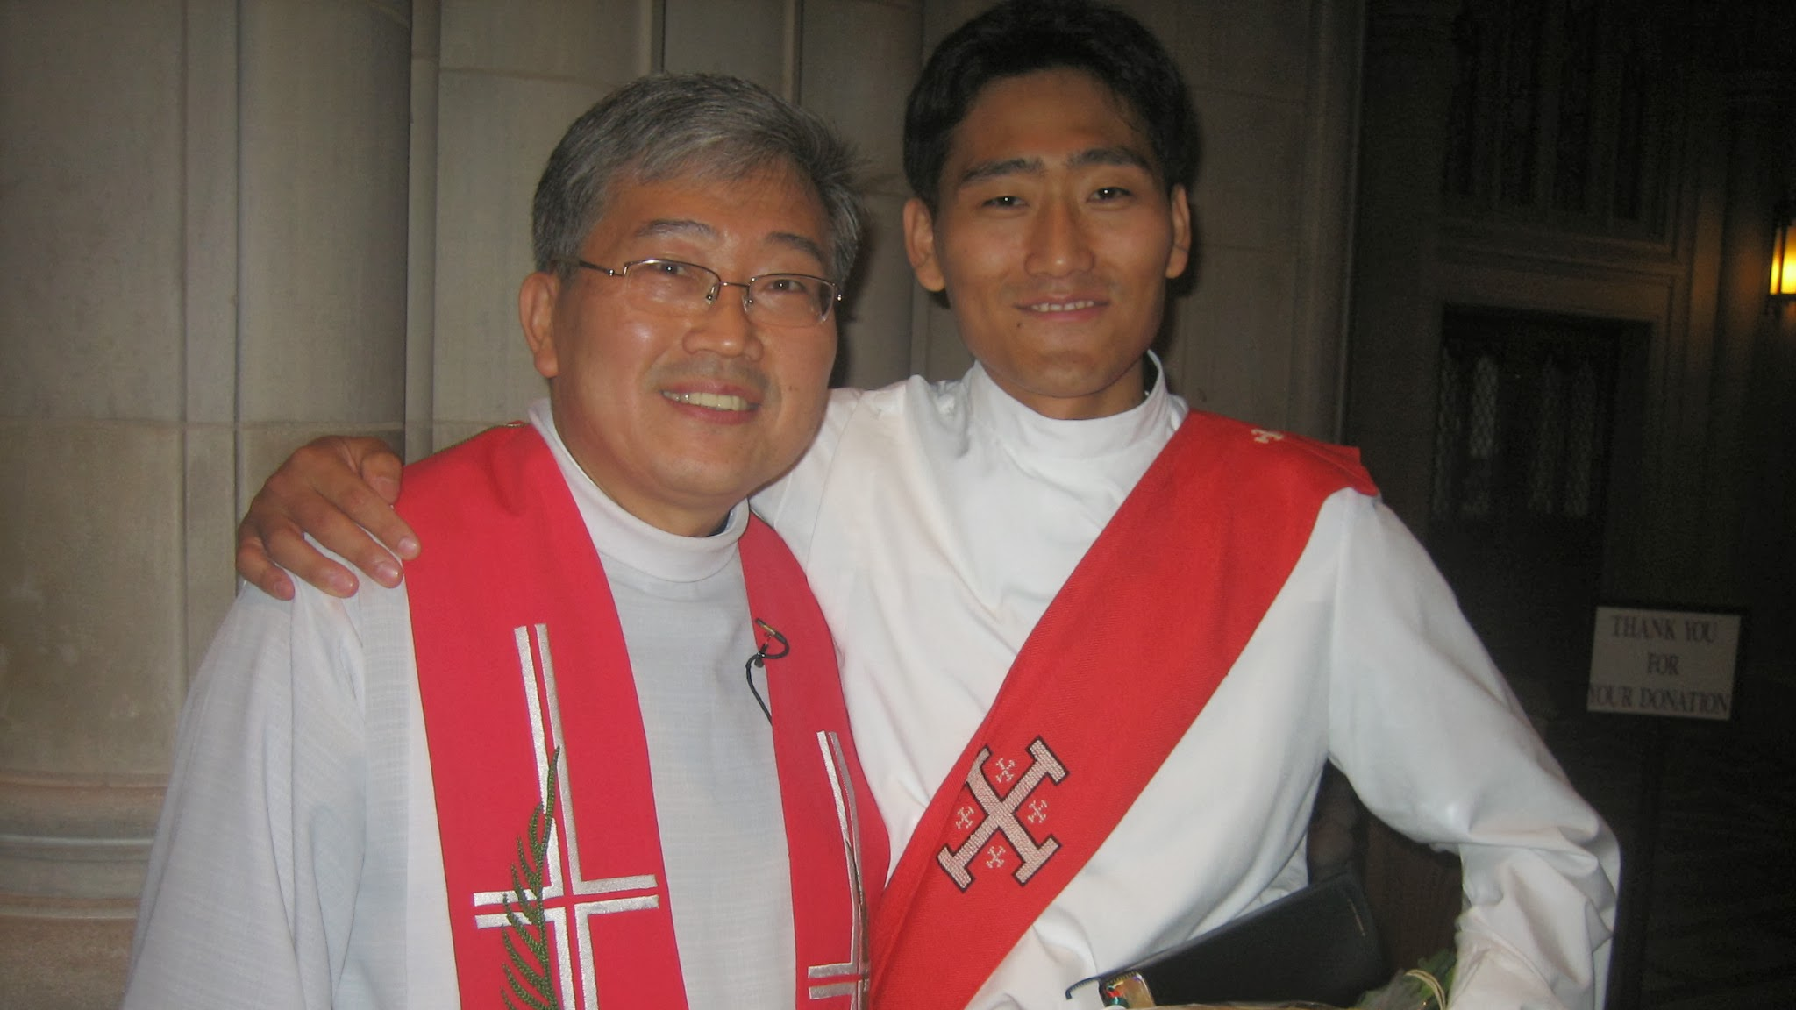

Slide 4

¹⁸ Then Jesus came to them and said, “All authority in heaven and on earth has been given to me. ¹⁹ Therefore go and make disciples of all nations, baptizing them in the name of the Father and of the Son and of the Holy Spirit, ²⁰ and teaching them to obey everything I have commanded you. And surely I am with you always, to the very end of the age.”
- Matthew 28:18-20

Slide 5
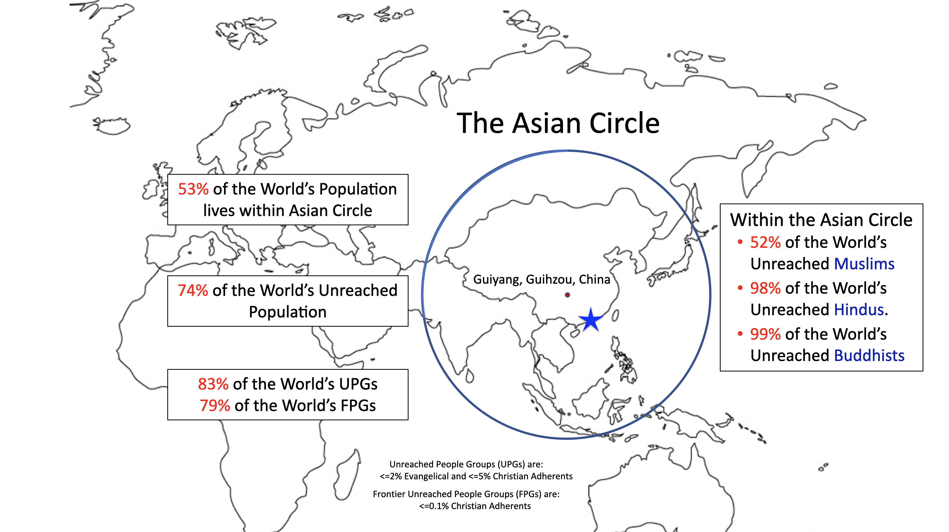
Notes:
Definition: Less than or equal to 5% Christian Adherent AND less than or equal to 2% Evangelical.
Joshua Project approximates Frontier People Groups as:
0.1% or fewer Christian Adherents and
no confirmed, sustained movement.

Slide 6
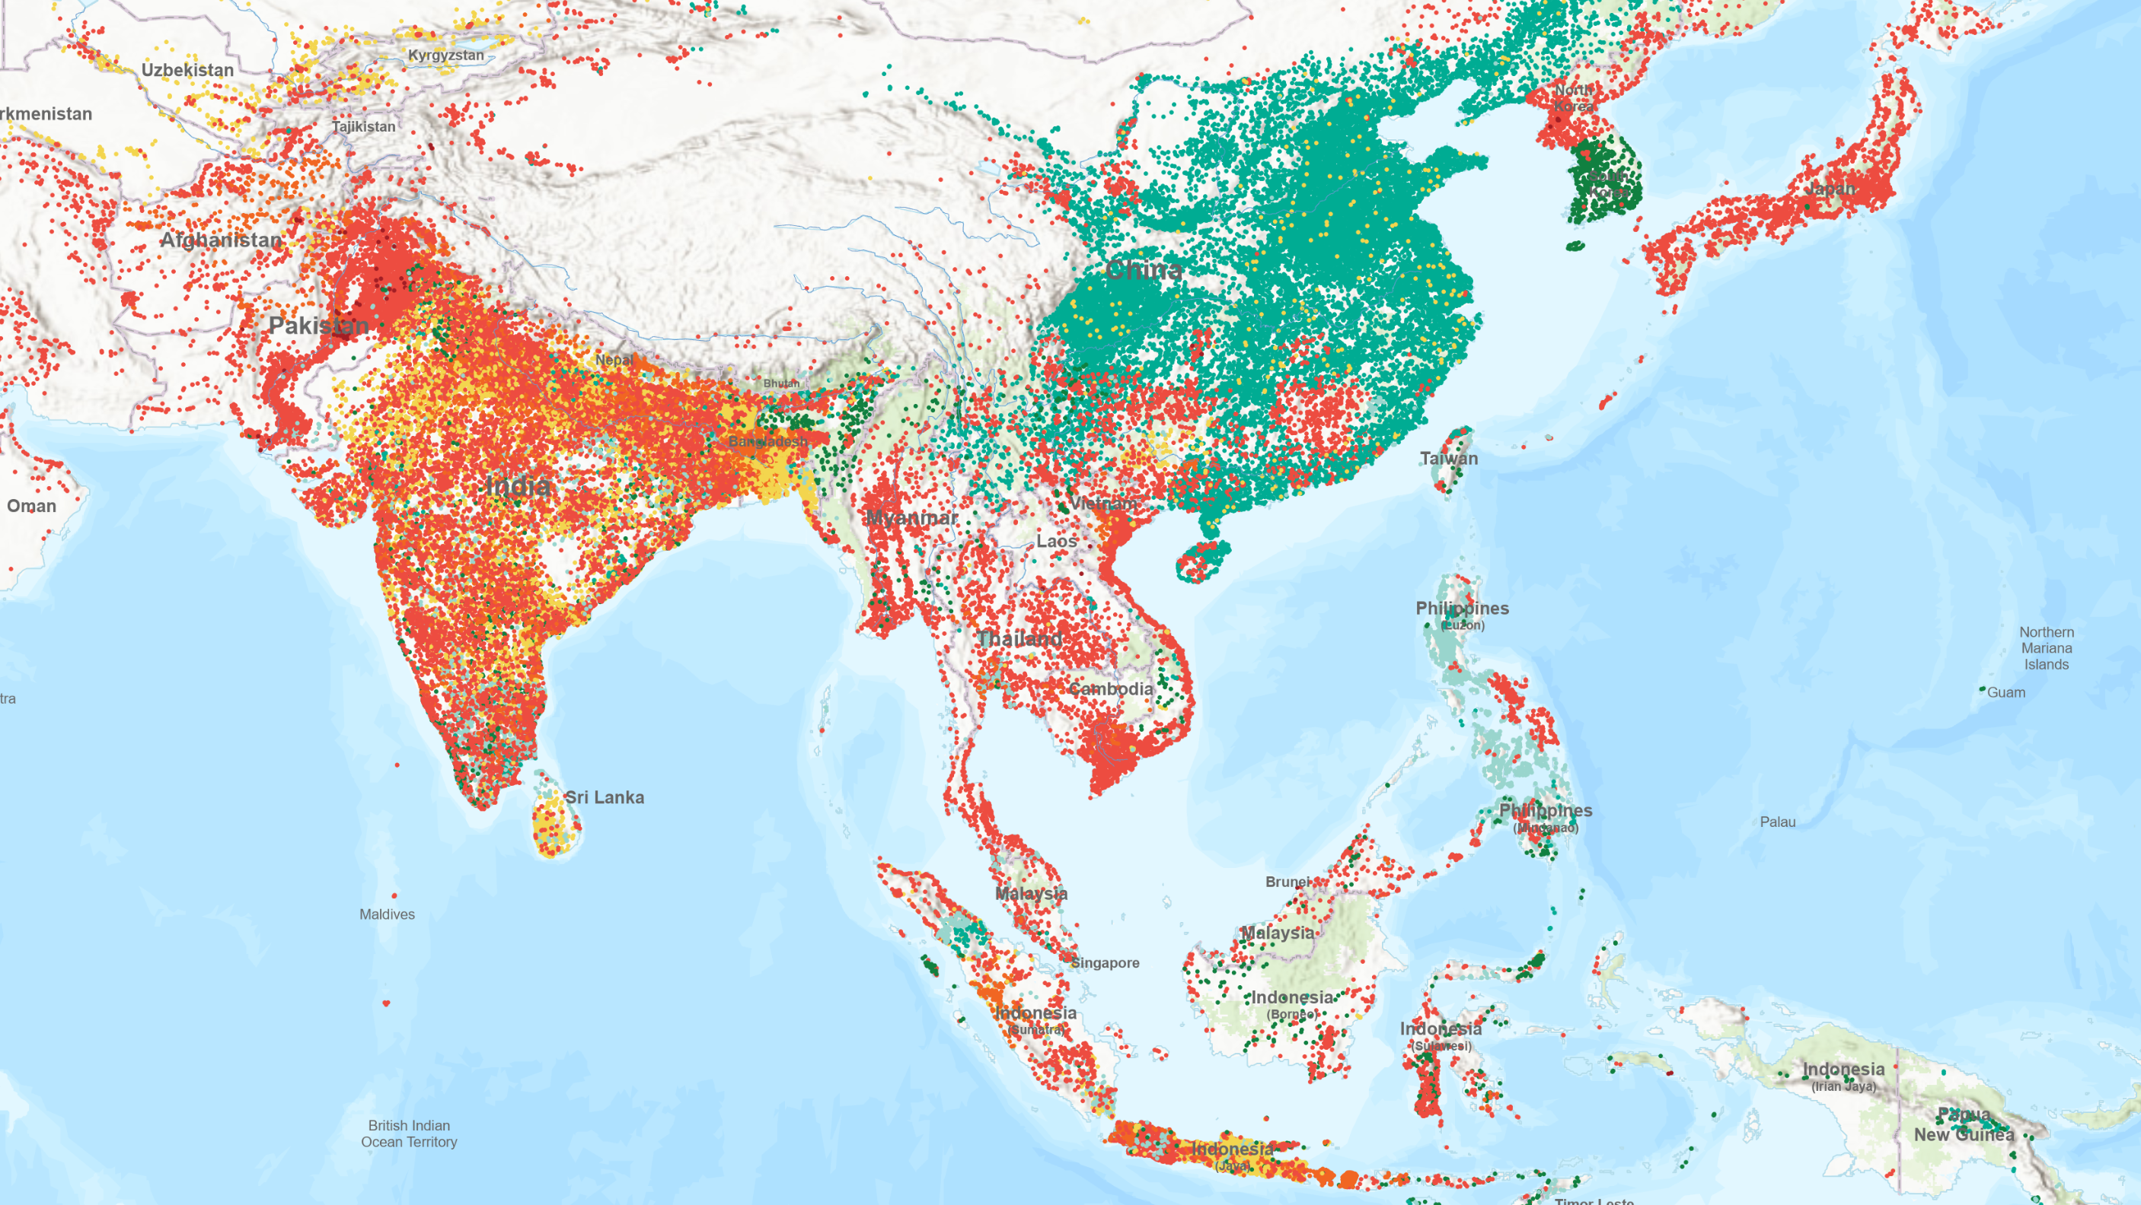
http://joshuaproject.net/

Slide 7
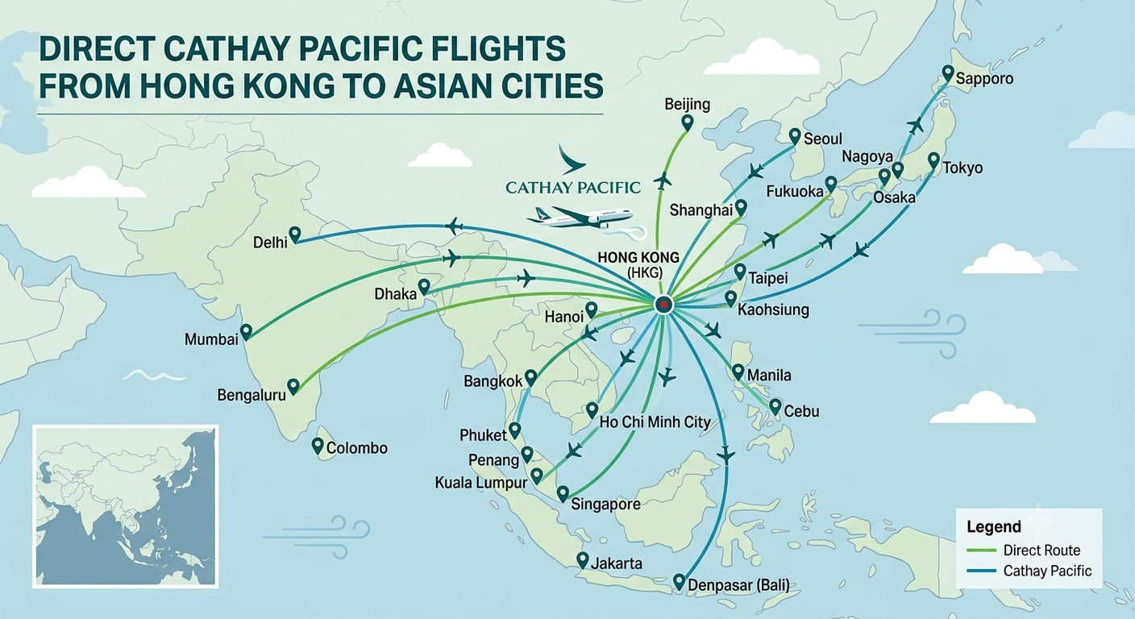

Slide 8
²⁶ From one man he made all the nations, that they should inhabit the whole earth; and he marked out their appointed times in history and the boundaries of their lands. ²⁷ God did this so that they would seek him and perhaps reach out for him and find him, though he is not far from any one of us.
- Acts 17:26-27

Slide 9
Pray for the mainland Chinese; Indian, Pakistani, Nepalese are the least reached with the gospel in the city. Pray for the Indonesian helpers (150k, mostly Muslim)
Join in mission trips to these places! Consider a life devoted to missions!
Pray as you go on your holidays; visit a local church (or an international church even)
Support our missionaries

