Slide 2


Slide 3
Clash of Kingdom: Greater Kingdom
Our Greater Allegiance (v.15-22)
Our Greater Hope (v.23-33)
Our Greater Love (v.34-45)

Slide 4
1. Our Greater Allegiance (v.15-22)

Slide 5
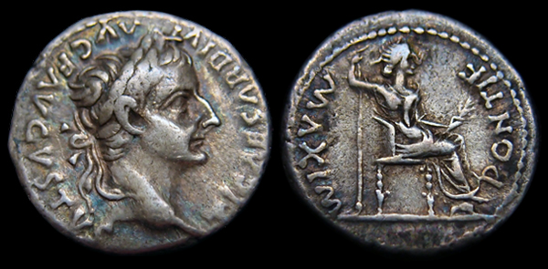
“So give back to Caesar what is Caesar’s, and to God what is God’s.”
- Matt 22:21b

Slide 6


“So give back to Caesar what is Caesar’s, and to God what is God’s.”
- Matt 22:21b

Slide 7

2. Our Greater Hope (v.23-33)

Slide 8
2. Our Greater Hope (v.23-33)
²⁹ Jesus replied, “You are in error because you do not know the Scriptures or the power of God.”
  Scripture promises resurrection
  God is able to recreate the heaven and the earth
Our hope should be in the in the new world!

Slide 9
2. Our Greater Hope (v.23-33)
The best of this life we enjoy with a few will be enjoyed with everyone in the new creation

Slide 10

3. Our Greater Love (v.34-45)
⁵ Love the Lord your God with all your heart and with all your soul and with all your strength (Deu 6:4-5)
but love your neighbor as yourself. I am the Lord. (Lev 19:18b).

Slide 11
3. Our Greater Love (v.34-45)
The Bible is about love
The Bible is about Jesus who is love and came to restore our relationship with him!

Slide 12
3. Our Greater Love (v.34-45)
The Lord says to my lord:
“Sit at my right hand
until I make your enemies
a footstool for your feet.”
(Psalm 110:1 by David)

