Slide 1
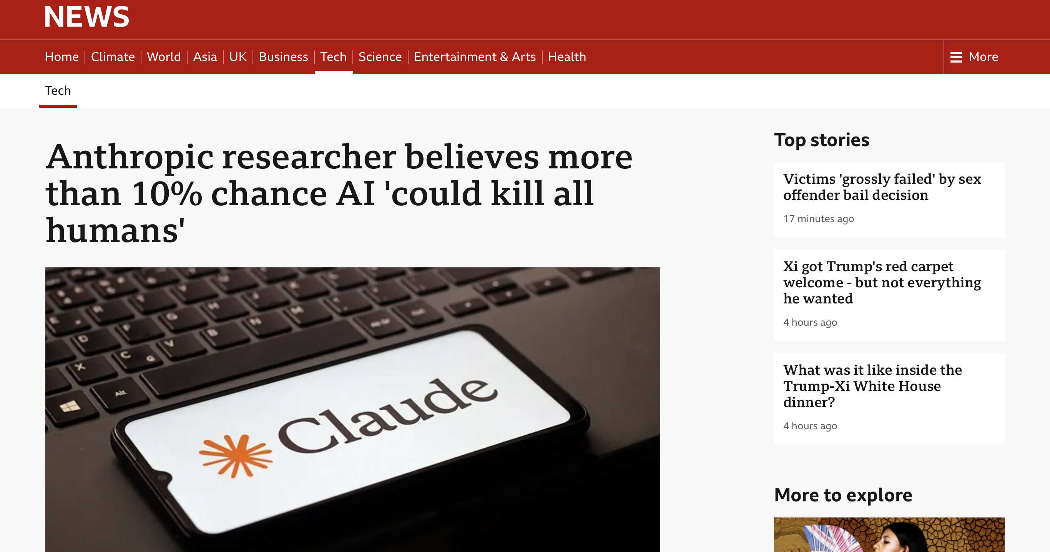

Slide 2
Until He Comes Again: Destined for Salvation
The Day of Judgment (v.1-3)
Children of Light (v.4-8)
Destined for Salvation (v.9-11)

Slide 3
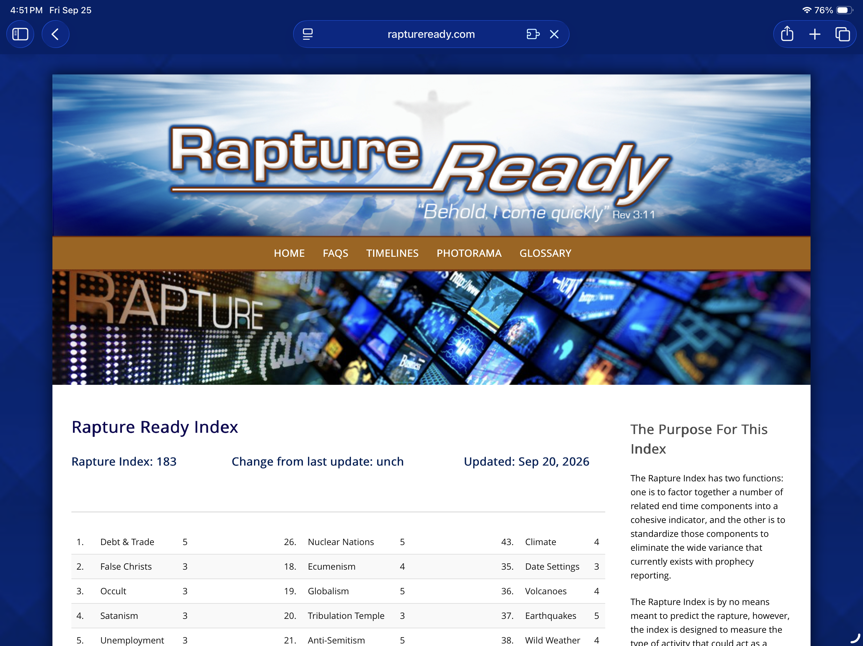

Slide 4
1. Day of Judgment (v.1-3)
5 Now, brothers and sisters, about times and dates we do not need to write to you,² for you know very well that the day of the Lord will come like a thief in the night.³ While people are saying, “Peace and safety,” destruction will come on them suddenly, as labor pains on a pregnant woman, and they will not escape.
  The date cannot be known!

Slide 5
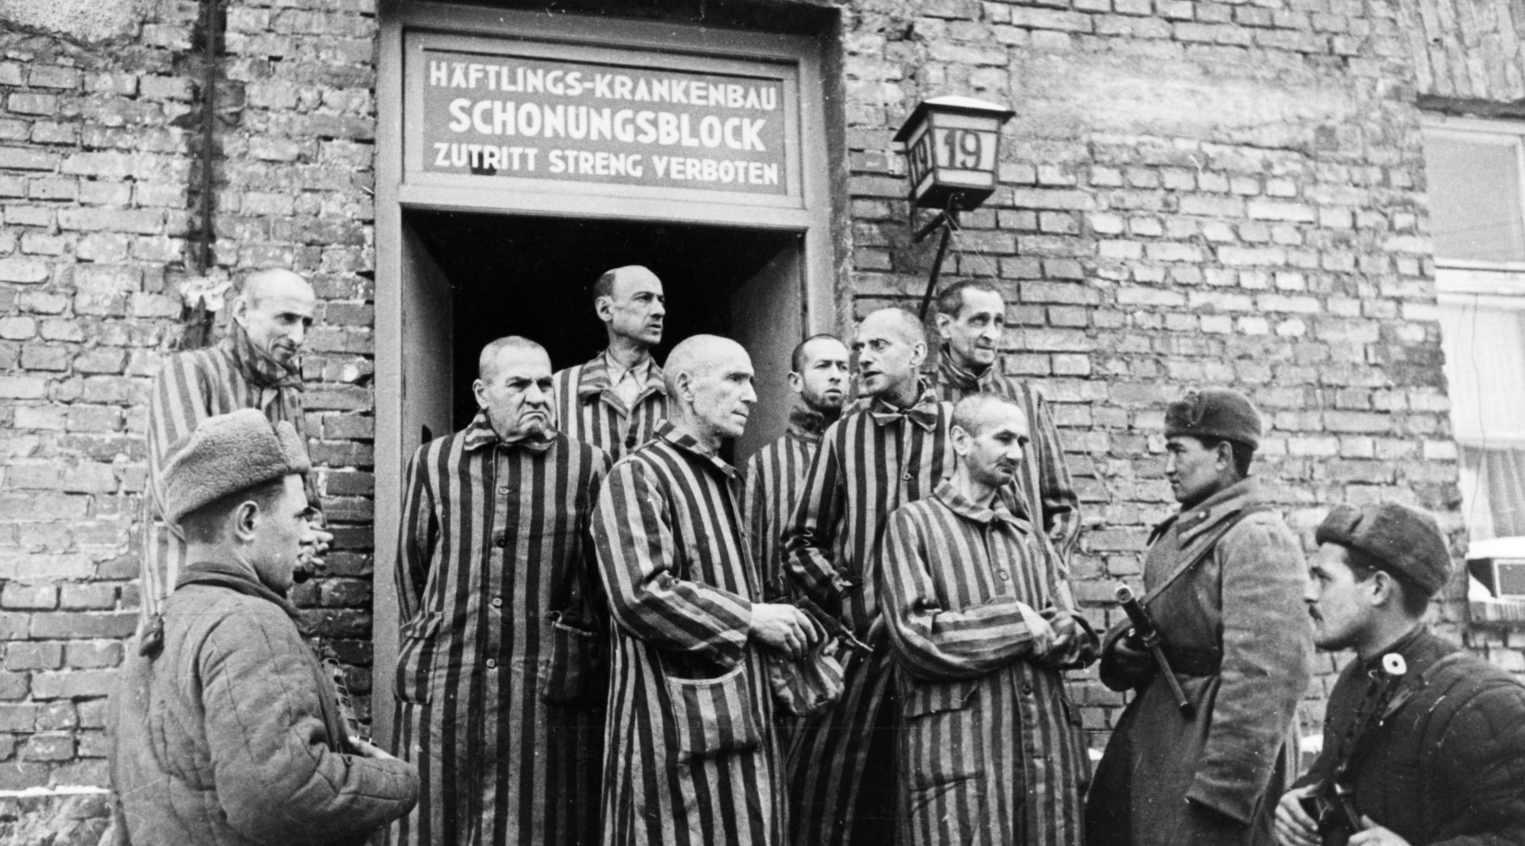

Slide 6
1. Day of Judgment (v.1-3)
The Day of the Lord is a day of judgment
  Isaiah 13:6, 9, Zephaniah 1:14, Joel 2:31-32…
  Amos 5:18, “Woe to you who long for the day of the Lord! Why do you long for the day of the Lord? What day will be darkness, not light!”

Slide 7
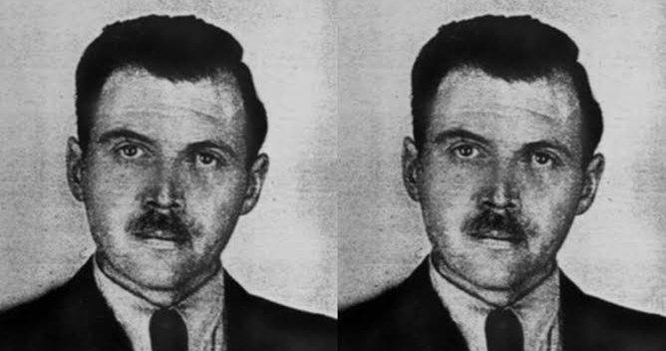

Slide 8
1. Day of Judgment (v.1-3)
5 Now, brothers and sisters, about times and dates we do not need to write to you,² for you know very well that the day of the Lord will come like a thief in the night.³ While people are saying, “Peace and safety,” destruction will come on them suddenly, as labor pains on a pregnant woman, and they will not escape.

Slide 9
1. Day of Judgment (v.1-3)
The day that we long for, the day of judgment and renewal will come!
Rather than striving to know the day, know Jesus!

Slide 10
2. Live as Children of Light (v.4-8)
⁴ But you, brothers and sisters, are not in darkness so that this day should surprise you like a thief. ⁵ You are all children of the light and children of the day. We do not belong to the night or to the darkness. ⁶ So then, let us not be like others, who are asleep, but let us be awake and sober. ⁷ For those who sleep, sleep at night, and those who get drunk, get drunk at night. ⁸ But since we belong to the day, let us be sober, putting on faith and love as a breastplate, and the hope of salvation as a helmet. ⁹

Slide 11
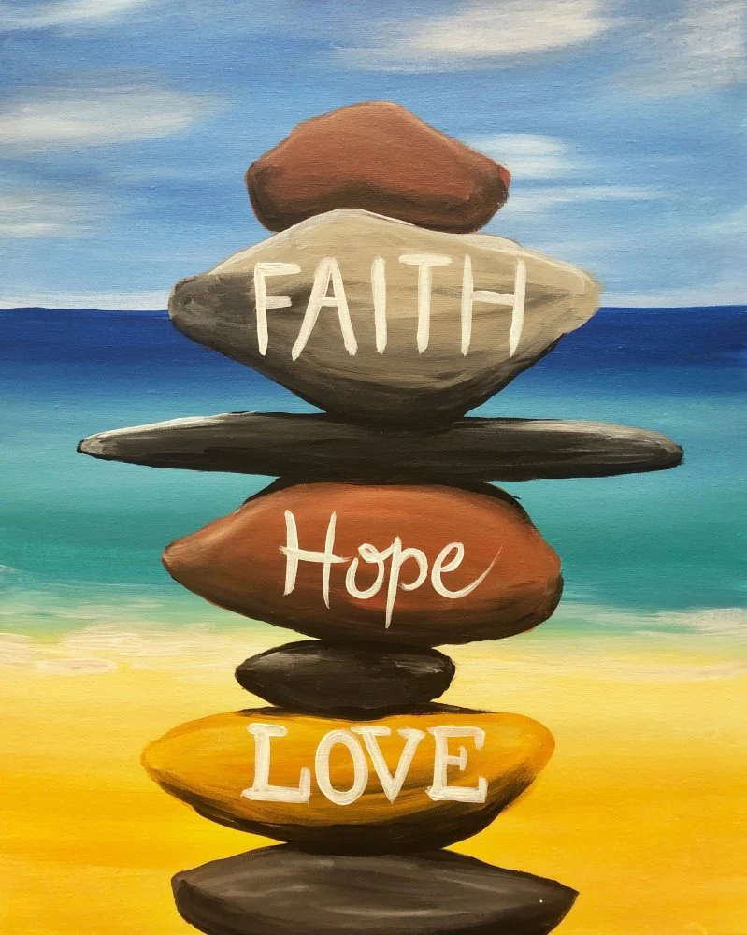
2. Live as Children of Light (v.4-8)
⁸ But since we belong to the day, let us be sober, putting on faith and love as a breastplate, and the hope of salvation as a helmet. ⁹

Slide 12
2. Children of Light (v.4-8)
Faith
  Turn away from superstition
  Keep the Sabbath
Love
  Love for the strangers
  Forgiveness
Hope
  Living for God’s Kingdom
  The way we face death

Slide 13

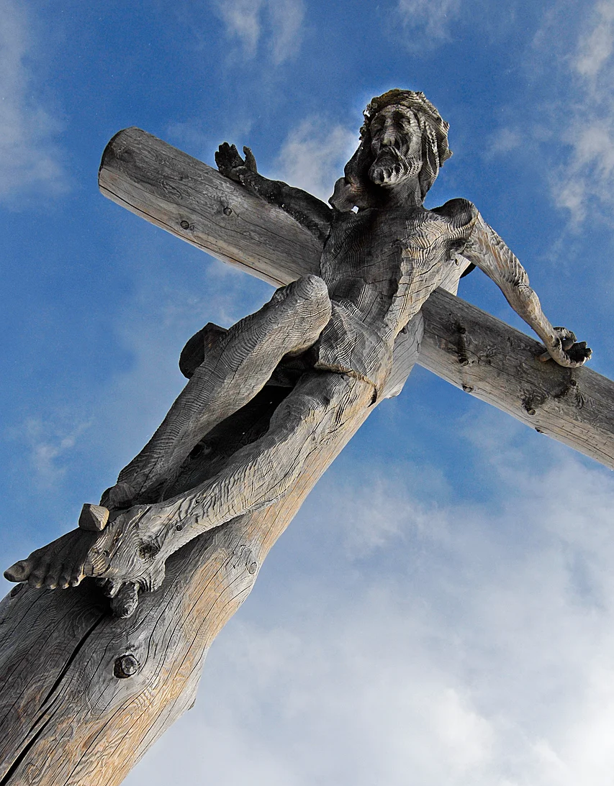
3. Destined for Salvation (v.9-11)
⁹ For God did not appoint us to suffer wrath but to receive salvation through our Lord Jesus Christ. ¹⁰ He died for us so that, whether we are awake or asleep, we may live together with him.

